Slide 1

High Efficient Scientific Habit with Advanced Intelligent Tools
报告人：阎林胤 博士
Speaker: Yan Linyin Ph.D.
Customer Consultant
Reed Elsevier Information Technology (Beijing) Co., Ltd
2017 Jan

Slide 2
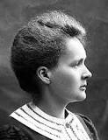
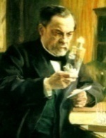
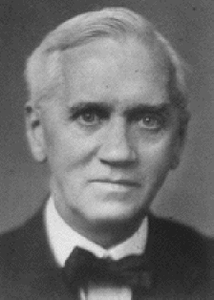
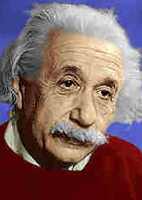

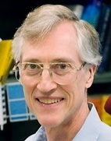



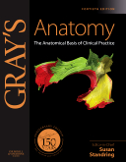



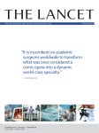




About Elsevier
Marie Curie
(Physics, Chemistry)
Louis
Pasteur
(Chemistry)
Alexander Fleming
(Medicine)
Albert Einstein (Physics)
Shinya
Yamanaka
(Medicine)
John C. Mather (Physics)
Francoise
Barre-Sinoussi
(Medicine)
Craig C Mello (Medicine)
Galileo’s last and greatest work, published in 1638 by Elzevir, Discorsi e Dimostrazioni Matematiche
Notes:
Elsevier is the second largest publisher in the world. It could data back 18th century. When researcher mentioned about Elsevier they are likely to turned to the outstanding journals. But in Elsevier, we talk more about our customers, the researchers. Elsevier is in a very good position so that we truly understand they are doing great things. They take great effort to advancing Science and technology, and transmission them. We know the out come they want to achieve and the challenge they are facing. With the advantage of these knowledge, we could make their work more efficiently and conveniently. That’s what we mean about Leading the way.

Slide 3

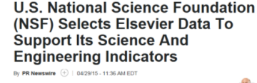


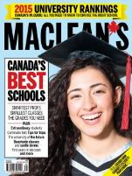









Elsevier is Leading the way
国家科研分析与比较
  US NSF Science & Engineering Indicators
  Research Performance in South-East Asia
  UK REF, UK BIS reports, British Council
  ERA (Australia)
  FCT (Portugal)
  VQR (Italy)
全球大学排名
  Times Higher World University Rankings
  Maclean’s
  QS rankings
  US News rankings (Arab Region)
科技前沿报告 (部分样例)
  US Council of State Governments
  NIH Best reports (including Cornell)
  Illinois Science and Technology Road Map
  SciDevNet,Sustainability Science (24 September)
  World Bank
  Royal Society
  Science Europe
  EuroStemCell, Kyoto University
  European Commission, FENS, HBP,
  Kavli Foundation, RIKEN BSI
Notes:
We could help them to understand what the scientific world is going on. We could help them to know the performance of their countries, their affiliations, their corporation or even themselves.

Slide 4






ScienceDirect是什么?
Elsevier公司的旗舰产品
全学科的全文数据库
得到130多个国家1100万科研人员的认可
中国用量最高的外文全文数据库之一
全面集成期刊（含回溯文档）和图书（单行本/丛书/手册/参考工具书）
在ScienceDirect平台, 最多可以查阅 3,800个不同期刊的全文, 以及超过35,000 册的图书。

Slide 5

The World’s Best Resource
In the last 5 years :
Researchers from World have downloaded from ScienceDirect 4,007,955,430 times documents written in 247 countries
Articles from World affiliated authors published on ScienceDirect have been downloaded 3,301,570,065 and cited 64,734,635 times
24%
53%
13%
Add Logo
10%
20%
27%
12%
50%
61%
11%
8%
12%
Source: Elsevier Web Analytics Department, Scopus Data 2011–2015
Notes:
In fact in the scientific research all over the world Elsevier is taking the most important position.
Over one fourth of the research progress in relative to Elsevier.

Slide 6
ScienceDirect 世界科研活动中贡献比例逐年上升
Referenced articles from
Articles published in
Citations received from
5e+07
5e+07
2,000,000
4e+07
4e+07
24460220
25858197
25042186
25483233
25175886
22699729
1,500,000
1380678
1392221
1297347
3e+07
23920797
3e+07
20356687
1274389
1327923
19671771
22077022
2e+07
5396746
5829511
6129828
6030469
1,000,000
2e+07
4353018
4449164
4530627
4820868
5586695
6086454
6099513
166386
167495
166463
173449
183906
3924471
4177710
6717073
6082997
4377542
5025392
500,000
228200
241839
265962
307944
282905
1e+07
4476596
5118591
5848924
1e+07
14331558
14253724
10838090
12062739
13248524
389870
397056
433446
467843
482002
8860835
9559178
10901516
11819158
12369505
0e+00
0
0e+00
2011
2012
2013
2014
2015
2011
2012
2013
2014
2015
2011
2012
2013
2014
2015
CAGR Elsevier: 5.63%
CAGR Elsevier: 4.33%
CAGR Elsevier: 6.90%
100%
100%
100%
75%
50%
50%
50%
49%
49%
75%
62%
61%
59%
58%
75%
53%
54%
53%
53%
52%
62%
50%
12%
12%
12%
50%
50%
12%
12%
7%
8%
11%
10%
10%
9%
9%
11%
11%
11%
12%
12%
8%
8%
7%
13%
12%
13%
13%
14%
13%
25%
25%
11%
11%
12%
13%
25%
27%
27%
27%
27%
28%
19%
19%
19%
20%
21%
24%
23%
24%
24%
26%
0%
0%
0%
2011
2012
2013
2014
2015
2011
2012
2013
2014
2015
2011
2012
2013
2014
2015
Source: Elsevier Web Analytics Department, Scopus Data 2011–2015
Notes:
And this trend is going on. As a publisher, Elsevier is growing even more important.

Slide 7
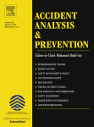

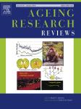
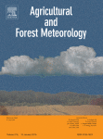

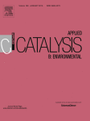
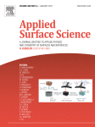
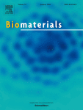
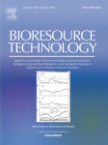
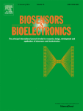

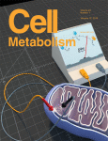

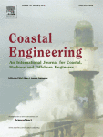

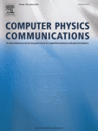
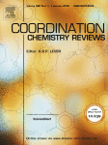
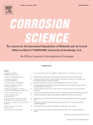

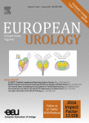


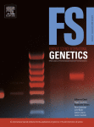
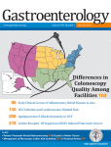
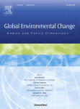
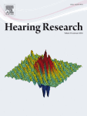
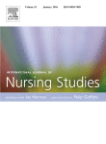
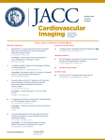
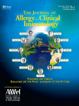
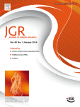
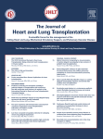
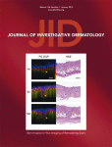
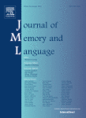

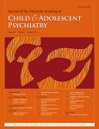
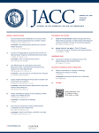

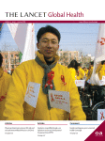
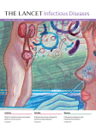
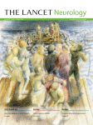
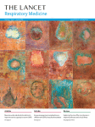
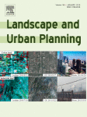
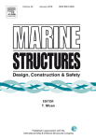
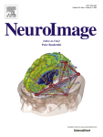

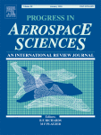


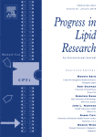

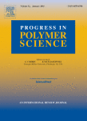


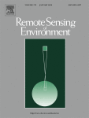

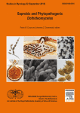

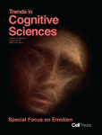

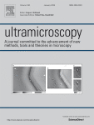


在学科门类中排名第一的爱思唯尔期刊 (2015)
2015年在71个门类中排名第一（共235个门类）
2014年在62个门类中排名第一 (共232个门类)
包括一本丛书：Advances in Organometallic Chemistry
来源: 2015年Thomson Reuters 期刊引用报告

Slide 8














































自由全文库包含大量各学科顶尖期刊
1847本期刊中：
71个门类排名第一(共235各门类)
287本刊排名前五
584本刊排名前十
1076本期刊排名前二十
来源: 2015年Thomson Reuters 期刊引用报告

Slide 9
How much time do you spend on literature exploring every week?
Notes:
One question, do you know How much time do you spend on literature exploring every week?

Slide 10
Exploring Literature
Time (in hours): Approximately how much time last week did you spend on the following activities?
 | Keeping up-to-date with your field | Searching online scientific literature | Managing research articles | Reading research | Annotating research articles and keeping a record of these | Developing hypotheses for investigation | Reviewing manuscripts (peer review) | Obtaining in-depth knowledge on a subject
Reading research
Keeping up-to-date with your field
Searching online scientific literature
Obtaining in-depth knowledge on a subject
The researchers’ challenge is in these use cases
Source: Researcher Behaviour, June 2014, Customer Insights
Notes:
Researchers spend most of their research time on exploring the published literature, for which they spend in average 11.4 hrs a week. Four activities that are highly important to researchers:
Keeping Up-to-Date with your Field (2.2 hrs)
Searching Online Scientific Literature (2.1 hrs)
Reading Research or Reviewing Articles (2.5 hrs)
Obtaining In-depth Knowledge on a Subject (1.8 hrs)
It’s quite a long time. Researcher could have used this time doing more valuable things. For example doing more experiments and testing their ideas. And it’s the researchers’ challenge.

Slide 11

ScienceDirect is poised to support researchers, allowing them to achieve more
Notes:
Facing the situation, most of you guys want our platform simper, smarter, and more comprehensive.
Good news for you, our SD platform is simper, smarter, and more comprehensive.
We could help you to be more efficient more effective and more informed.

Slide 12





Key Features of the Modern Literature Data Base
Notes:
In addition, ScienceDirect Platform is a modern intelligent data base.
For a Modern Literature Data Base, four basic Features should available.
It could help to discover,
it could keep you informed of the latest news.
It shows you the detailed information.
And It’s convenient.

Slide 13



The Article Recommender
Helping researchers discover relevant information
“Others who have read this article mostly read the following…”
Notes:
“Others who have read this article mostly read the following…”
This sentence shows you the way. Just as convenient as Tianmao and Jingdong. You’ll certainly get what you want.

Slide 14











Content Innovation
Giving access to the detail
Pathway Studio
Graph Plotter
Arabidopsis gene viewer
Virtual Microscope
Radiological images viewer
NIF Antibody app
Open Data
3D virtual environments
3D CIF molecular viewer
Interactive Case Insights
(Click icons for more info)
Notes:
Detailed information is available on the SD platform. A sequence of useful tool had been developed.
Researcher from every subject would find something interesting.

Slide 15


ScienceDirect is becoming Personal, Social and Connected
Example: NEW Landing Page for TOP 25
Author Stats links to Mendeley Social, providing researchers with a view on the dissemination of their work
Top articles takes researchers to intelligent content recommendations
Keep them informed of the latest developments and news
Notes:
As your close friend in academy. ScienceDirect will show you the latest influential articles. So you can keep in the frontier of the research area.

Slide 16



ScienceDirect is becoming Personal, Social and Connected
Example: Authors can Access and Integrate Data Sets with Mendeley Data
Make the process quick and easy
Authors can easily share data
+
Give access to the detail
Researchers have access to data
Notes:
ScienceDirect is becoming Personal, Social and Connected
It has become a interesting community of researchers. Sharing and exchange becomes more easily.

Slide 17


ScienceDirect is starting to help researchers become connected, social and personal
Authors are posting their AudioSlides on Twitter
Notes:
Researchers can also discover articles via social media,
and authors are able to promote their research by
linking to content innovations via their social media profiles
Very close to academic twitter or academic youku.

Slide 18






Research is changing… and thus, so is the way we present information
From “print science” to “digital science”
  Research is more than text & images – data, code, multimedia etc. are all becoming first-class citizens
  Pressure on efficiency is greater than ever: need to be able to find articles, understand them, and re-use results efficiently and effectively
  → We strive to use modern web technology for an optimal reading experience
Notes:
Research is changing… and the way to present information is also changing.
2D printing could not meet the need of delivery of the complex information.
Science is From “print” to “digital”

Slide 19



Multiple devices & time online: responsive website
19
Notes:
Now the ScienceDirect platform is also on your cell phone. You can read literatures everywhere.

Slide 20

ScienceDirect Platform
Search effectively supports the four most frequent research tasks and is available on every page:
Related articles by searching specific keywords
A specific author name
A specific journal/book title
A specific article by publication/ vol./ issue/ page search
Notes:
Next we move to the most basic and core function of ScienceDirect Platform
the Searching Engine.
In every page, there is a input table for the basic search tasks.
The four most frequent research task are available.
You may also notice that the remote access is also available, which we would introduce latter on.

Slide 21



快速检索某一特定文献
方式1：输入文献全名
方式2：输入期刊名、卷（期）、页码
I. Diez-Perez, C. Vericat, P. Gorostiza, F. Sanz, ELECTROCHEM COMMUN 8 (2006) 627.

Slide 22


高级检索
所有资源
期刊
书籍
参考书
图片/视频
检索字段
检索词
资源类型
所属领域
出版时间

Slide 23




高级检索

Slide 24


检索历史保存和调用

Slide 25

Search Functionality – Expert Search
Notes:
For customers having higher demand for customization in search, There is expert search in the ScienceDirect platform.
Command line is supported. With simply organized commands customized search is available.
Following is some of the examples of the logical operator and command terms.

Slide 26
专家检索
常用检索字段 | 字段名（Field_name）
 | 字段全称 | 简写编码
所有字段 | all | all
题名/摘要/关键词 | title-abs-key | tak
标题 | title | ttl
摘要 | abstract | abs
关键词 | keywords | key
作者 | authors | aut
特定作者 | specific-author | aus
参考文献 | references | ref
期刊/图书名 | srctitle | src
作者机构 | affiliation | aff
专家检索模式： Field_name(search_term)

Slide 27
检索语言
AND | 默认算符，要求多个检索词同时出现在文章中
OR | 检索词中的任意一个或多个出现在文章中
AND NOT | 后面所跟的词不出现在文章中
通配符 * | 取代单词中的任意个（0,1,2…）字母 如transplant* 可以检索到transplant, transplanted, transplanting…
通配符? | 取代单词中的1个字母 如wom?n 可以检索到woman, women
W/n PRE/n | 两词相隔不超过n个词，词序不定 quick w/3 response 两词相隔不超过n个词，词序一定 quick pre/2 response
“” | 宽松短语检索，标点符号、连字符、停用字等会被自动忽略 “heart-attack”
{ } | 精确短语检索，所有符号都将被作为检索词进行严格匹配 {c++}

Slide 28
检索语言
拼写方式
当英式与美式拼写方式不同时，可使用任何一种形式检索
例：behaviour 与behavior; psychoanalyse 与psychoanalyze
单词复数
使用名词单数形式可同时检索出复数形式
例：horse -horses, woman –women
希腊字母
支持α, β, γ, Ω检索（或英文拼写方式）
法语、德语
重音、变音符号，如é,è,ä 均可以检索
大小写
英文字母不区分
上下标
To search H₂O，enter H2O

Slide 29





Journals by Subject Areas
Notes:
Sometimes we want to find journals by subject areas.
There are four major areas Xx,Xx,Xx and XX
Containing 24 subject.
We could also find the journal by indexing the journal title.

Slide 30




Search Results Page
1
2
3
7
8
4
5
6
1
Search Results
4
Sorting Option
(Relevance or Date)
7
Download Multiple PDFs
2
Search Alert
(Save & RSS Feed)
5
Access Rights
8
Export
Search Refine
(Limit to or Exclude)
6
Display Article Pages
(Show preview | PDF | Recommended Articles)
3
Notes:
Search Results
Search Alert and RSS
Search Refinement Parameters
Sorting Options into Relevance/Date
Access Rights: Green is subscribed, White is no subscription, Orange is open access
Display Article Pages: show preview/PDF/Recommended Articles
Download Multiple PDFs
Export

Slide 31



Use the Intuitive Online Article Format
5
4
2
1
New and valuable types of content
3
Provides easy navigation
Navigator Bar
Citing & Recommendation
Articles
More Options
1
3
5
2
Related Articles
Author Information
4
Notes:
The articles page in ScienceDirect present a three-pane design for simple design and will feature tools that will improve your user experience, beyond viewing the PDF article format. The articles will appear on the center page and the style will be similar to those that you see in PDF.
In addition to the main body of the articles, there is an articles outline on the first pane that provides easy navigation and access any supplemental data when needed.
To enhance the reader’s experience, there is a recommended articles and citing articles on the third pane (right side) of the page which will help users to discover relevant materials in ScienceDirect as well shows articles which cites the current articles that you are viewing. Specific tools that is relevant to your articles like interactive maps, audio, 3D images may be available.
1. Expand citing articles
3. Can email author
4. Expand image as well. Update tags

Slide 32



Use the Intuitive Online Article Format
3
1
2
1
Articles
2
Download image
Image / Powerpoint format
3
More Options
Notes:
By clicking on the articles on the first pane, it will bring you to the images within the articles, saving the reader’s time to scroll up & down to find the same information. You are even able to download the image or save it as part of the power-point slides.
By clicking on the image, it will open as a side-bar as shown on figure 3 which will allow you to refer to the figures / image as you continue to read the articles.

Slide 33


Download Multiple PDFs
Batch Download and Automatic Naming
  Download multiple PDF files and assign them names based on specified rules (Author, Publication Year, Article Title, journal, etc)
  Maximum number of PDF files – 25 per download
  Java required
Notes:
Multiple PDF downloading is supported in ScienceDirect platform.
with the recommendation and multiple download. The collection of literatures is very efficient.

Slide 34









Journals by Subject Areas
Notes:
In this page the journals could be found by subject browse.

Slide 35

6
5
2
4
3
1
1
Access Rights
Export Bibliographic
Information - Citations
4
6
Journal Information
2
Volume List
(Articles in Press)
Volumes/Issues Alert or RSS Feed (Registered Users only)
5
3
Display Article Page
(HTML or PDF)
Notes:
Enter the journal you will find 1. 2. 3. 4……….

Slide 36


Elsevier eBooks
26 Subject Areas (Science & Technology and Health Sciences): 33,000 books
http://www.elsevier.com/online-tools/sciencedirect/collections
Notes:
As we have mentioned previously, the e-books and journals are not separated on ScienceDirect.
There are 26 subject of ebooks.

Slide 37


Book Content Types on ScienceDirect:
eBooks (including textbooks)
> 33,000 titles
26 subject collections
Irregular, discontinued series, monographs
eBooks/Monographs: A scholarly book or treatise on a single subject or a group of related subjects, usually written by one person or a group of contributing authors. It is a one-time, non-serial publication that is complete in itself. It may refer to a detailed, well-documented work on a specific subject or person
eTextbooks: Manual of instruction in any course or branch of study. It is a teaching tool which presents the subject matter defined by the curriculum.
Handbooks
6 series
Regular series
A collection of authoritative information in a mature research field, or a particular technique for ready reference. Designed to be easily consulted and prove quick answers and data in a certain area, chapters can serve as self contained surveys, often defining a field. Manuals are included in this category.

Slide 38


Book Content Types on ScienceDirect:
Major Reference Works & Reference Modules
> 150 titles as at 2015
3 Reference Modules (Earthy system & Environmental Sciences, Biomedical Sciences & Chemistry, Molecular Sciences & Chemical Engineering)
2 upcoming in 2015 (Food Science & Materials Science & Materials Engineering)
Encyclopedias and Comprehensives
Major Reference Works: The distilled, established knowledge of a particular field, discipline or subject of interest. It can take the form of an encyclopedia, with short articles grouped within alphabetically arranged entries, or a comprehensive work, comprising longer entries arranged by subject association.
Reference Modules: Combine thousands of related Elsevier reference work articles into one evolutionary source of trustworthy information, now kept current. Articles are continuously reviewed by a renowned Editorial Board, and time-stamped as of the last review or update.

Slide 39


Book Content Types on ScienceDirect:
Book Series
> 60 titles as at 2015
Series titles
13 subject collections
Regular series
A varied collection of reviews and essays on current research in a particular field or a comprehensive overview of a topic. The series are published regularly, at least once per year, and are highly cited and have a high usage per article. The series articles are similar to journals in content and structure, yet present a more lengthy examination of a subject area than is possible in a traditional journal article.
Legacy
9,500 titles, with more than 100 by Nobel Laureates
This is a deep backlist scanning and digitization project bringing often unavailable books from the mid-20th century to the present to ScienceDirect
# Book titles change weekly, for up to date and complete list:
http://www.elsevier.com/online-tools/sciencedirect/books/tiles

Slide 40


Award Winning Book Titles available via ScienceDirect:
Notes:
Elsevier’s books keep on a very high quality
many of the ebooks have won awards.

Slide 41

eBooks HTML Webpage
Search within this book by keyword(s)
About this book content
Download PDFs by Selected chapter(s)
Notes:
This is the webpage of ebook, from which we could … …. .,..

Slide 42



Using Personal Functions
4
1
2
3
1
Register Now
Registered User Agreement
E-Mail News Alert
3
2
User Registration
User-Login In
4
Notes:
The personal functions could be used on the ScienceDiret. The setup is convenient.

Slide 43


Using Personal Functions
1
1
My Alerts
(Search | Topic | Journal/Book-series)

Slide 44
Exercise: Remote Access设置
Remote Access的主被动设置
Remote Access 主动设置：
用户打开SD主页，在未进入文章主页面或者搜索结果页面下载或者浏览全文之前，主动设置Remote Access，即为Remote Access的主动设置。
Remote Access被动设置：
用户在SD平台上进入文章主页面或者搜索结果页面下载或者浏览全文时，发现不能成功，这时想通过设置Remote Access来浏览或者下载全文而进行Remote Access的设置，即为Remote Access的被动设置。
Remote Access成功设置并登录以后，半年内有效，半年内无需再设置
Notes:
Remote access is one of the most useful function.
Here we introduce the setup of the remote access.
We can open the remote access of SD platform or Scopus platform or Scival via the following two ways.
The initiative activate and the passive activate.
By either method, once we logged in and activated the remote access, we could use it for 6 months.

Slide 45
Remote Access 主动设置方法
Notes:
First let’s try the initiative activate.

Slide 46

打开SD主页，用自己的用户名密码登录后，下方Activate remote access按钮
Notes:
Open the SD homepage, click on the right up button, the activate remote access button would appear.
Click the activate remote access button.

Slide 47

进入到Submit Your Email界面输入所属单位邮箱并点Continue
Notes:
The window of submit your email will be automatically opened.
Input your email address into the textbox.
Click on the button, continue

Slide 48

成功发送confirmation email到输入的邮箱
Notes:
A email would send spontaneously to your email box.

Slide 49

到邮箱里点击Activate my remote access now激活Remote Access
Notes:
Check the mailbox and find the email with the hyperlink. Significantly marked Activate my remote access now.
Clink on it.

Slide 50

Remote Access成功设置
Notes:
The Remote access will be successful activated.
See, So easy.

Slide 51
Remote Access 被动设置方法
Notes:
Now we look at the passively activate of the remote access. It’s even easier than the initiatively one.

Slide 52

Self-managed remote access
用户在机构之外第一次使用SD的时候进入上图的文章主页面，如果点击Submit your email address输入机构email地址，注册或者登录，然后进入邮箱激活Remote Access。这是基于该email地址是可识别的，如果该email地址不能被识别，则进入下一页。
Notes:
Passively means you don’t need to activate it. When you want to open the full text of the article or download PDF file, you will be asked to activate the remote access or pay for the article.
Do not choose pay for the article so you can save the money.
Choose activate the remote access.

Slide 53

未识别用户的Remote access设置
有时候SD不能识别用户的机构邮箱，那么用户需要输入机构邮箱，并且填写相关信息以供识别，然后进行remote access设置，然后进入邮箱激活。
Notes:
Following the instruction and input your information and most importantly the email address.
The email address would be recognized as the ID of you in your university, and the remote access would be activated.
See, Even easier.

Slide 54
Writing scientific papers
Notes:
Beside reading a scientific papers, we would also learn to write some. How would you do it?

Slide 55






高效能的论文写作注意以下事项
关注成功
  什么样的研究能够发表？
及时处理数据
整理文献
牢记目的
  工作的安排需要围绕中心
  补数据
走出实验室
  竞争&合作
  其他人的观点
设置最终期限

Slide 56
a.寻找合适的期刊
期刊寻找：
参考文献的期刊
期刊排名与影响力 Journal Ranking
寻求导师或同事的帮助
导师或同事通常也是合作作者，对论文负共同责任
寻找热点主题 top25.sciencedirect.com
Elsevier Journal Finder
对于目标期刊：
研读期刊的 Aims & Scope及Guides for Authors
并检查文章是否符合期刊要求
查看期刊是否只接受邀请投稿
查看期刊的出版是否满足需求
查看期刊是否符合资助机构的要求

Slide 57

推荐阅读
Davis, M. (2013) Scientific Papers and Presentations, 3rd Edition, Academic Press
Grossman, M. (2004) Writing and Presenting Scientific Papers, 2nd Edition, Nottingham University Press
Clare, J. and Hamilton, H. (2003) Writing Research Transforming Data into Text, Churchill Livingston
Lagendijk, A. (2008) Survival Guide for Scientists; Writing -Presentation, Amsterdam University Press

Slide 58




文章撰写与投稿的实用工具
期刊寻找：
Scopus分析出的相关期刊
参考文献的期刊
期刊排名与影响力 Journal Ranking
Elsevier Journal Finder
对于目标期刊：
研读期刊的 Aims & Scope及Guides for Authors
并检查文章是否符合期刊要求
查看期刊是否只接受邀请投稿

Slide 59



CrossCheck
Compares full-text manuscripts against a database of 38+ million articles from 175,000+ journals, books from 500+ publishers, and 20+ billion webpages.
Notes:
Another useful tool is Cross Check it’s for the comparing of your work with others. If the sentences are identical you will get to know, and change the words or orders.
As in china, English is a second language, small vocabulary would easily cause the similarity.
Four year ago my roommate was preparing his manuscript.
He typed every single letter, but get a similar over 48%.

Slide 60
Effective Collaboration
Notes:
Collaboration will brought about excellent work. But sometimes it also brought about problem.
Because in collaboration, there is technique. Then, How to do it? What should we pay attention to?

Slide 61



Collaboration
Within the same field
Cross different fields
Quantitate the performance
Clear the responsibility right and profit
Notes:
There are two types of collaboration. One is within the same field the other is cross different field.
Anyway, no matter which one, we need to quantitate the performance of the potential partner.
Also We need to clear the responsibility right and profit.
Behaviors in Collaboration should be professional.

Slide 62

Visiting the lab
Knowing what you won’t do
The necessity of the visit
Famous expert
Show your strength
Strain capability
Notes:
When you have decide to collaborate with someone. Maybe you will visit his or her labs.
Here is what we need to take notice.
First we need to kn……….

Slide 63

Collaborations Around Yourself
Within the lab/ institute / local community
Communication with your colleagues
  Especially the new ones
Pay attention to details
Notes:
Finally as the Chinese saying goes, a good neighbor is better than a brother far off.
Collaboration with local researcher is more effective.
All of the information of the potential collaborator could be found in the platform of Mendeley.

Slide 64





覆盖科研全程的Elsevier工具
文献调研
课题选择
实验设计
实验开展与实现
结果验证与分析
科研成果发表
现在科研热点与前沿在哪？
社会与产业目前最急迫需求在哪？
完成本课题组承担的重大项目，尚需哪些科研结果？
现在本实验室设备与仪器条件可以支持哪些研究？
世界范围内，同行课题组的科研动向如何？
本课题组有何特色？在哪些研究方向具有竞争力？
世界范围内最先进的技术水平如何？
该技术有何局限性或者提升空间？
如何顺利完成实验中的技术攻坚？
是否在实验技术上突破了国际水平？
是否在实验中有了全新发现？
如何更好的宣传课题组的新发现？
如何将科研发现推广到更广阔的领域？是否有工业化价值？
Elsevier’s Solution
Notes:
In a word, Nowadays Elsevier has developed a full sequence of products to cover the whole Research process.

Slide 65

https://www.publishingcampus.elsevier.com/pages/1/Home.html

Slide 66

WebHelp
Notes:
In addition The webhelp of SD is also very convenient.

Slide 67

更多信息请参考爱思唯尔中国网站
http://www.elsevier.com/online-tools/sciencedirect
Notes:
There is also Chinese website.
It’s the localization strategy of Elsevier. My colleagues and I have done much work on it. But the update of Chinese website is relatively slower than that of the English website.
OK sometimes significantly slower.

Slide 68

欢迎加入我们的交流群:
306230973
公众号:
爱思唯尔Elsevier
Thanks For Your Attention！
china.elsevier.com
010-85208800
sginfo@elsevier.com
阎林胤 博士 l.yan@elsevier.com
2017 Mar

Slide 69
Choosing &. handling your Ph.D. adviser

Slide 70






Choosing Ph. D. adviser
兴趣
科研方向
科研产出
科研团队
科研经费
…
注意！文献情报的调研工作在这一阶段已经开始！

Slide 71





H-index

Slide 72

Handling your Ph. D. adviser in a professional way
与导师交流
  一切合作的基础
与导师保持联系
  让导师了解你的进展
更多的了解你的导师
  全方位的信息（课题组进展情况、导师最近生活与工作状态）
  基于了解的无障碍沟通，务必做到避免误解
获得导师的尊重
  展现自己独立的见解，提出更好的假设与建议
坚持自己的权利
  学会对位高权重的人提出要求的能力
多写文章
  与导师最有效的合作方法

Slide 73

From Motivation to Action
Motivation
Executive Planning
Action
刚性
科学合理，可执行
弹性

Slide 74
Time Management & Performance
长远的规划，较高强度、刚性的日常工作
必要的弹性，维持积极的心态与活力
危机处理能力与科研风险评估
高效的多重任务完成能力
健康的身心

Slide 75
Handling the literature
What is literature?
What can we do with literature?
What Tools could we use?

Slide 76
Universities Have a lot of literatures
文献的处理需要有目的有策略
例，全学科全文数据库ScienceDirect 所含期刊及书籍覆盖的领域及数量
物理科学与工程(1146, 11781)
  化学工程学(150,802
  化学(183,1736)
  计算机科学(208,2074)
  地球和行星学(173,522)
  能源(108,527)
  工程(346,4238)
  材料科学(231,1383)
  数学(131,1028)
  物理学和天文学(191,1408)
生命科学(1093,5645)
  农业和生物学(313,2294)
  生物化学/遗传学/分子生物学(478,2241)
  环境科学(215,681)
  免疫学和微生物学(198,340)
  神经科学(205,521)
健康科学(1683,3210)
  医科和牙科(1479,2408)
  护理与卫生保健(212,547)
  药理学/毒理学/制药科学(177,474)
  兽医学和兽医用药(71,254)
社会科学及人文(697,4458)
  艺术与人文(70,1107)
  商业/管理/会计学(146,1047)
  决策科学(82,41)
  经济学/计量经济学/金融(139,544)
  心理学(186,699)
  社会科学(351,1248)
数据截至2015.1.15，括号中前者为期刊数目(共3534种)，后者为书籍(单行本、丛书、手册，参考书)数量(共23229本)。

Slide 77
文献类型、特点与使用目的
综述
综述
弄清楚基本的概念
专著
专著
弄清基本的原理、方法
文献
资源
期刊
当今研究现状及要解决的问题
期刊
工具
文摘库，分析工具，专业工具
工具

Slide 78
不同的科研信息的获取途径
专业工具
题名文摘
文献全文
专家直接指定
文献被引情况
文献信息搜集过程
需要处理的数据量

Slide 79
文献检索工具的使用
>5000家出版社
2万多种期刊图书
会议论文 & 专利信息
Scopus
最大的文摘数据库
全面的数据信息量
多学科
强大的分析功能
配有多种文献计量工具
帮助用户对科研内容进行分析、跟踪和可视化研究
61 million records
最早的到1823年
84%以上的是1996年之后
24个大学科
334个子学科

Slide 80
检索策略的改进
关键词检索
信息比较杂乱
人物与被引用信息检索
信息干净
检索出无关的信息
不成系统，需要花费大量的时间去概括总结
直接排除无关信号的干扰
阅读起来比较方便
更容易形成系统
了解全球著名的实验室
了解该领域的研究动向和动态
助于培养我们的科研思维

Slide 81

关键词检索

Slide 82


检索结果

Slide 83
检索结果的分析

Slide 84

检索结果的分析

Slide 85
检索结果的分析

Slide 86

领域中最活跃的研究机构

Slide 87

领域中最活跃的研究人员

Slide 88


作者信息

